Slide 1
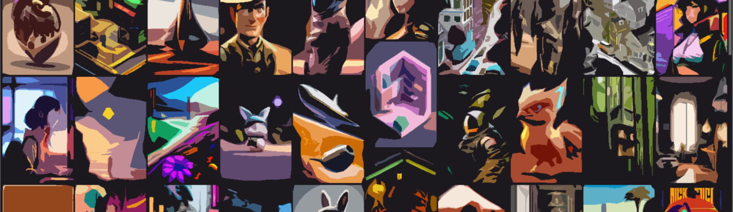
Stable Diffusion
احمد محمود حسيني
علي ماهر عبدالسلام
محمد احمد طه
محمد حسام عثمان
محمد عاطف ربيع

Slide 2
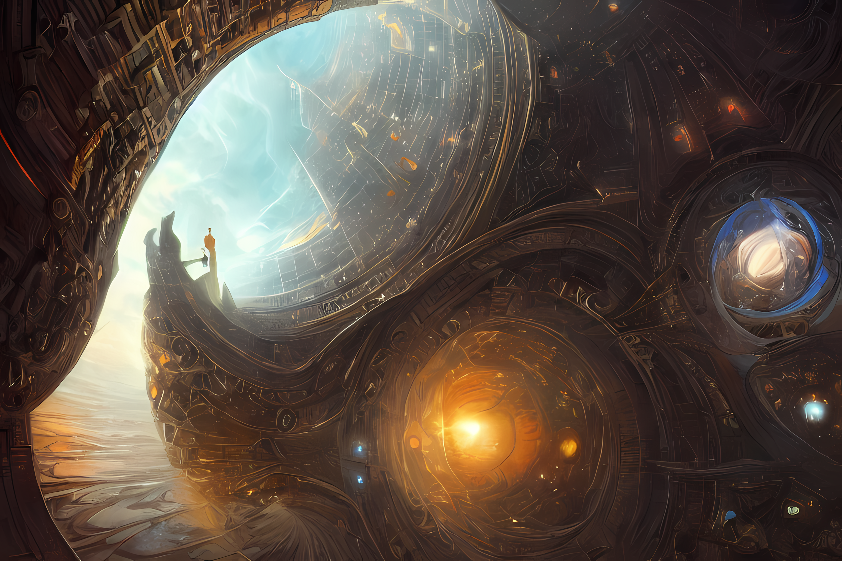
Content
Introduction
Model
Experiments & Results
Conclusion

Slide 3
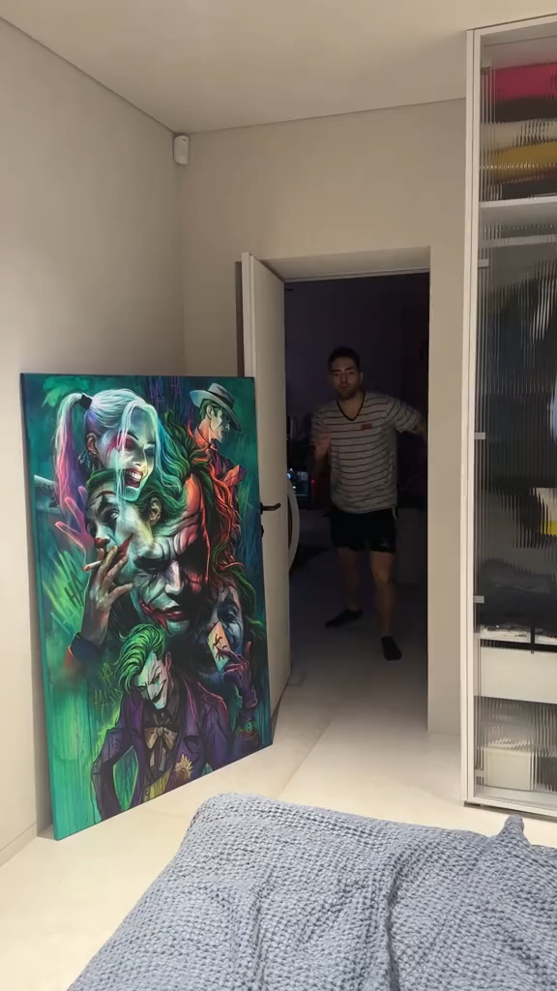
Text to Image Generation
Stable Diffusion
Introduction
Text to image synthesis is a process of generating an image from a given text description
The goal is to create an image that accurately reflects the content of the text
We will discuss a paper called “High-Resolution Image Synthesis with Latent Diffusion Models” also called Stable Diffusion

Slide 4
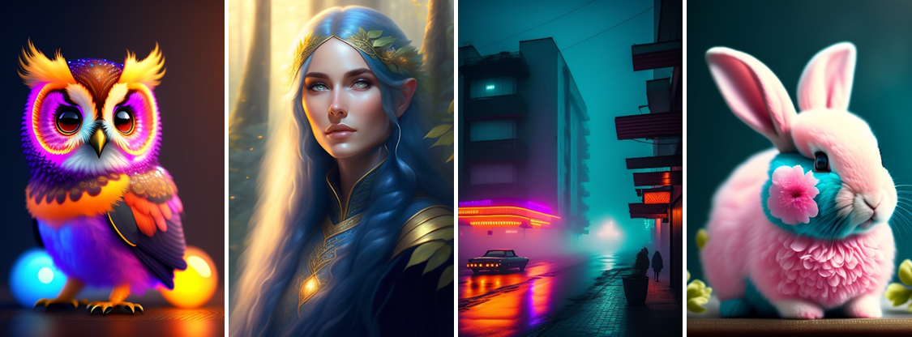
What’s the deal with all these pictures?
Stable Diffusion
Introduction
A realistic cute adorable baby owl made of crystal ball with low poly eye's surrounded by glowing aura highly detailed intricated concept art with vivid beautiful colors trending artstation 8k
A cute wizard elven, blue long hair, golden eyes, in a forest, simple dress, intricate, elegant, highly detailed, digital painting, hyper realistic, fantasy, dungeons and dragons, art by artgerm and greg rutkowski
streets of 1980s pripyat with neon lights in a foggy rainy night
Shabby Chic Teal and Pink Flowers with Fluffy Realistic Rabbit

Slide 5
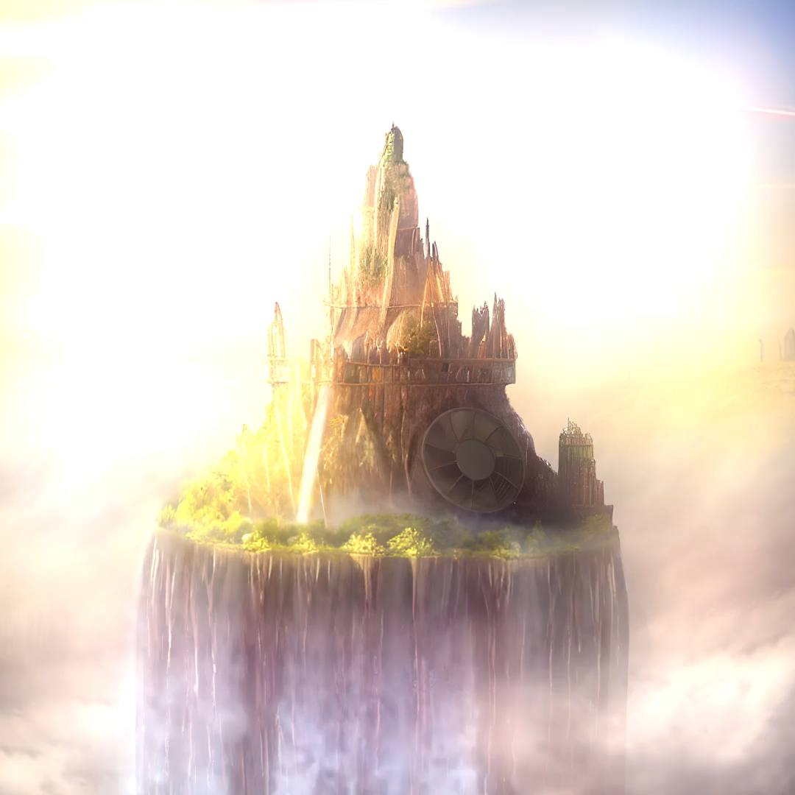
Stable Diffusion
Stable Diffusion
Introduction
These pictures were generated by Stable Diffusion (August 22, 2022) , a recent diffusion generative model
It can turn text prompts into images. It can also do a variety of other things!
You may have also heard of DALL·E 2, which works in a similar way

Slide 6
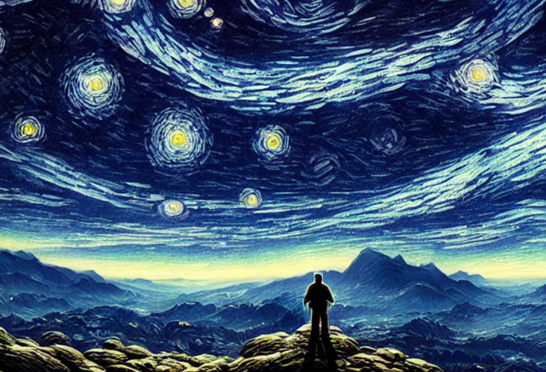
Content
Introduction
Model
Experiments & Results
Conclusion

Slide 7
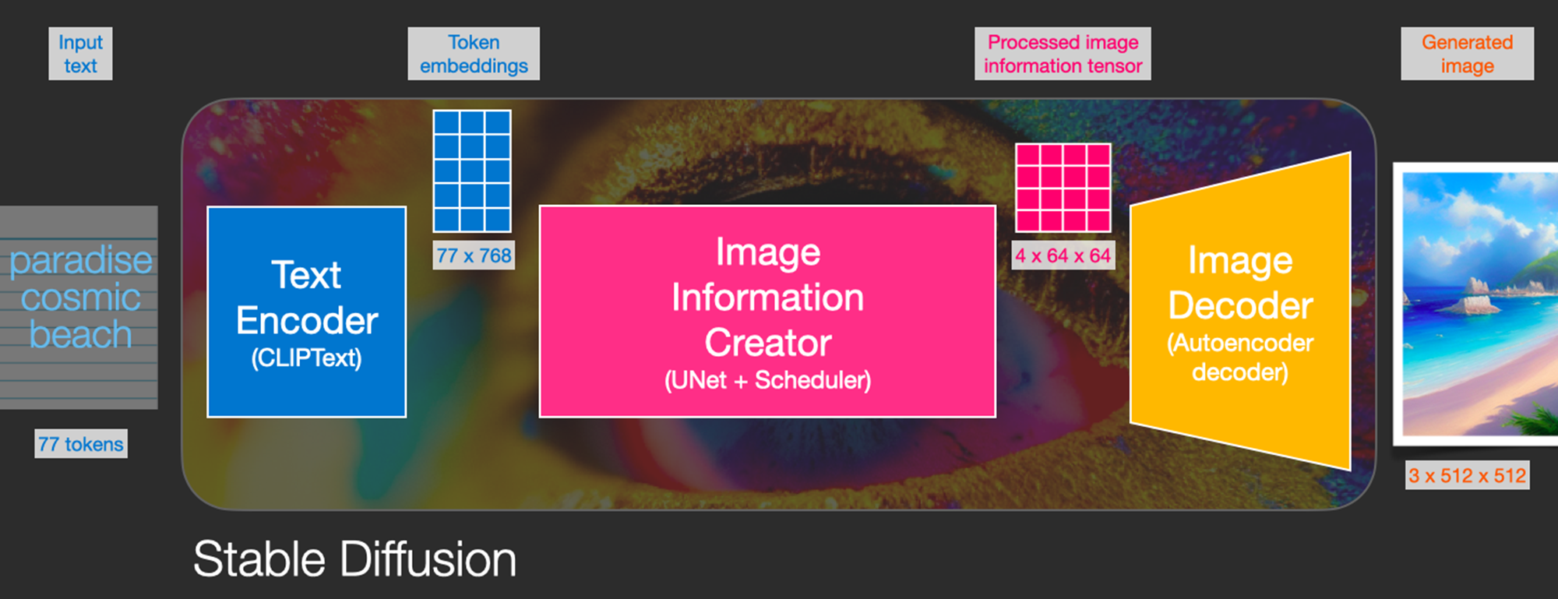
Model’s Top-down View
Stable Diffusion
Model

Slide 8
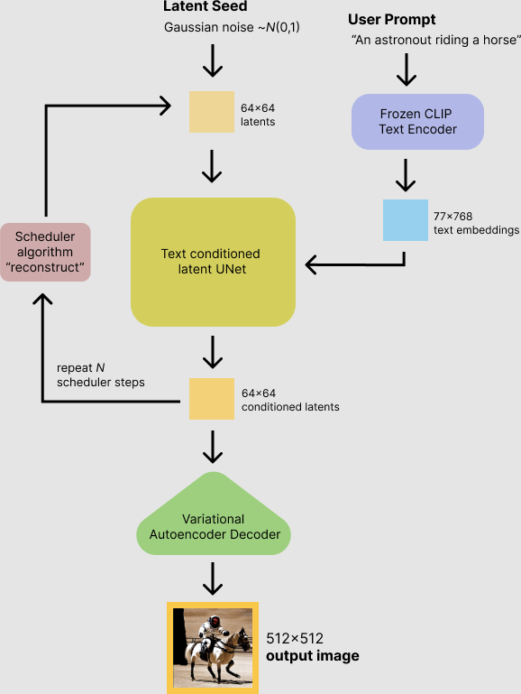
Model’s Top-down View
Stable Diffusion
Model
ClipText for text encoding.
Input: text + image.
Output: 77 token embeddings vectors, each in 768 dimensions.
UNet + Scheduler to gradually process/diffuse information in the information (latent) space.
Input: text embeddings and a starting multi-dimensional array (structured lists of numbers, also called a tensor) made up of noise.
Output: A processed information array
Autoencoder Decoder that paints the final image using the processed information array.
Input: The processed information array (dimensions: (4,64,64))
Output: The resulting image (dimensions: (3, 512, 512) which are (red/green/blue, width, height))

Slide 9
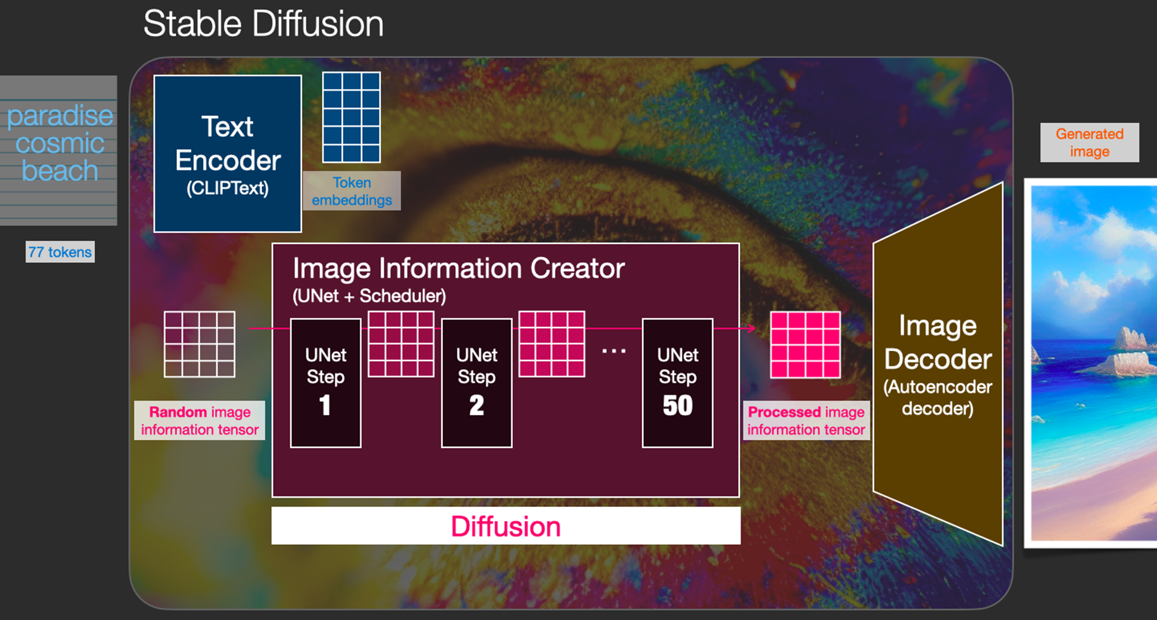
Model’s Top-down View
Stable Diffusion
Model

Slide 10
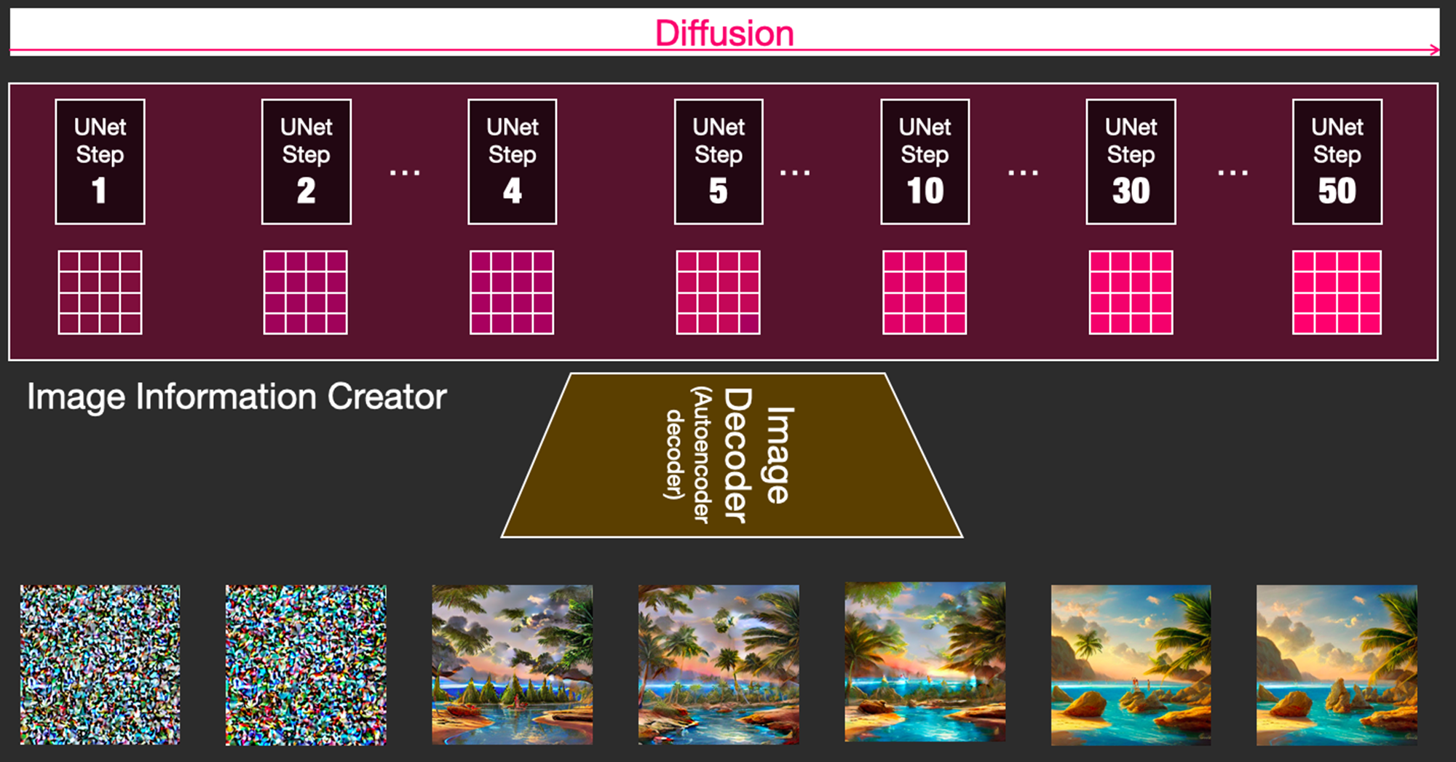
Steps Parameter
Stable Diffusion
Model

Slide 11
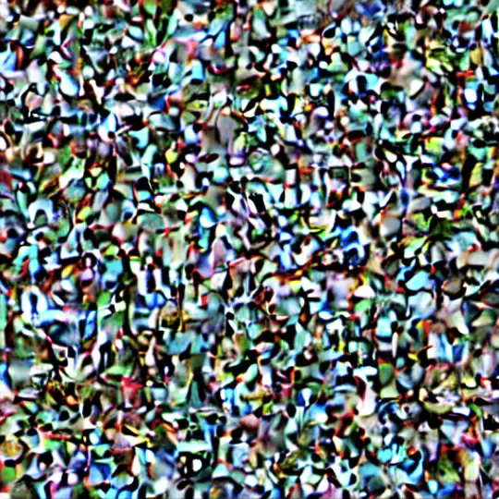
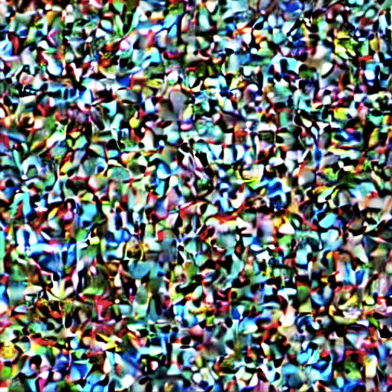
Steps Parameter
Stable Diffusion
Model
Diffusion - all steps
Diffusion - steps (2:4)

Slide 12
Text Encoder (CLIPText)
Stable Diffusion
Model
The model understands language by using a Transformer language model like GPT and BERT.
Stable Diffusion uses OpenAI’s CLIPText pre-trained model.
CLIP is trained on internet images and their “alt” tags, i.e., their alternative captions.
It encodes the image and its caption using image and text encoders, and the resulting embeddings are compared. The models are trained so that both text and image embeddings are similar.
Negative examples are also included, and the model is trained to assign them low similarity scores.

Slide 13
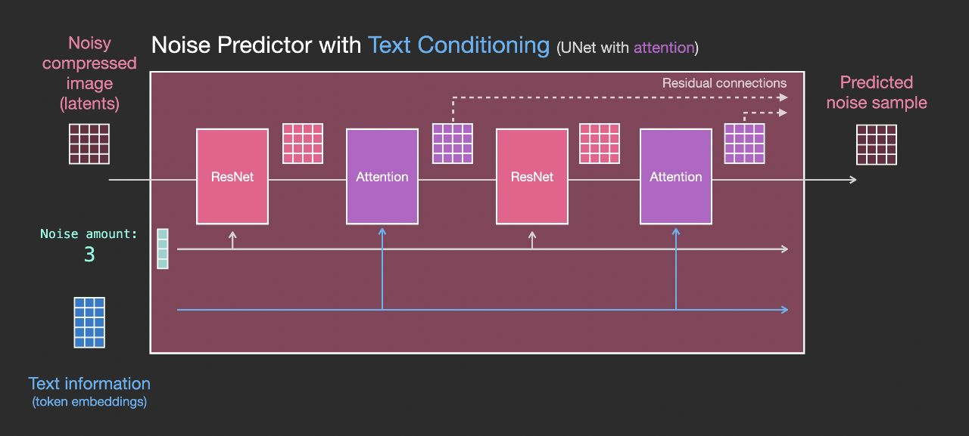
Text Encoder (CLIPText)
Stable Diffusion
Model
An attention layer is put between the ResNet Blocks
the attention layers merge the text representations in the latents

Slide 14
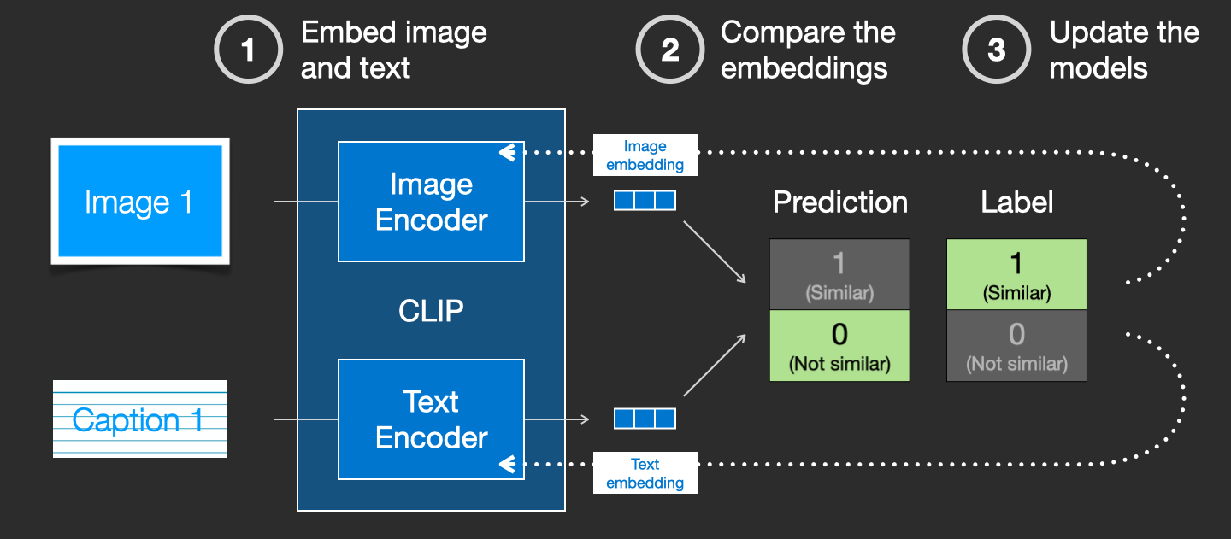
Text Encoder (CLIPText)
Stable Diffusion
Model

Slide 15
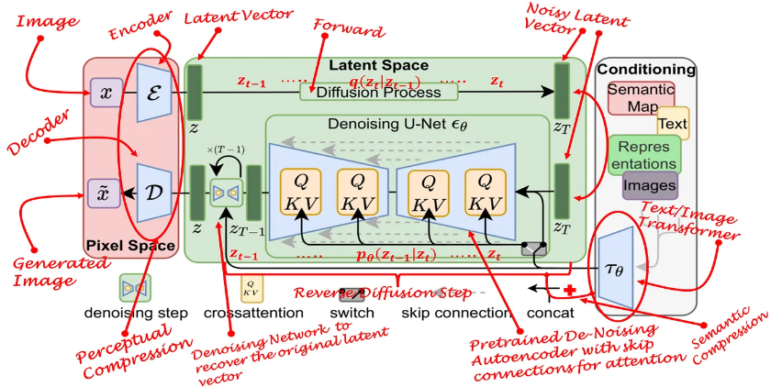
-Model architecture
Stable Diffusion
Model

Slide 16
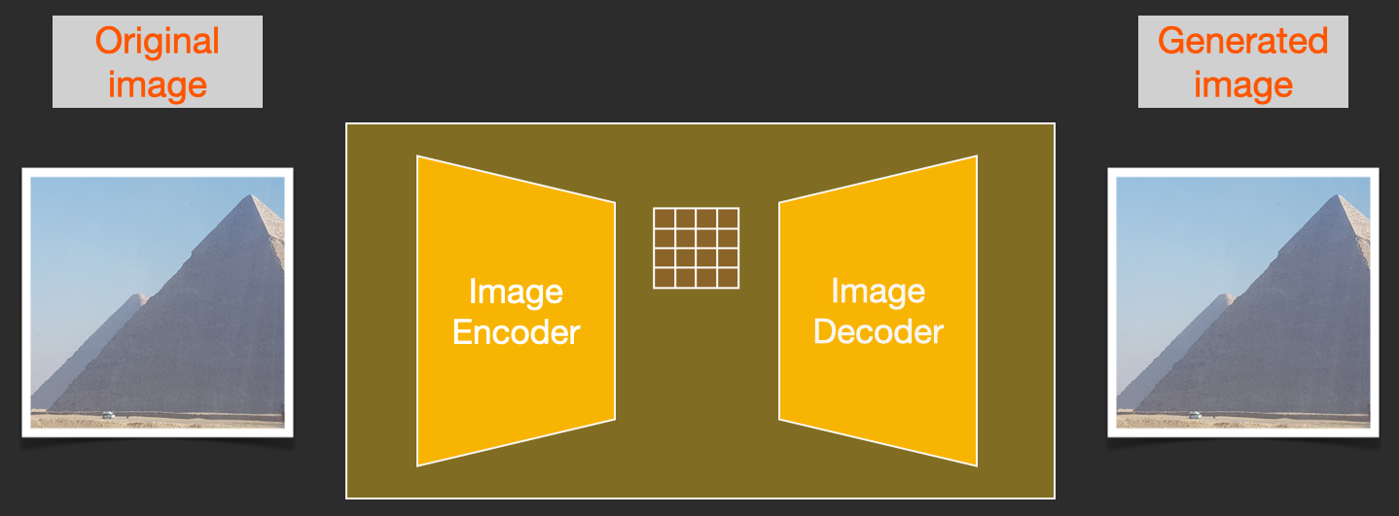
1- Latent space Autoencoder (AE)
Stable Diffusion
Model
To speed up the image generation process.
The encoder in the AE compress the input image from the pixel space into a hyperspace called latent space, while the decoder in the AE returns the image back to the pixel space.
Notes:
-To speed up the image generation process, the Stable Diffusion paper runs the diffusion process not on the pixel images themselves, but on a compressed version of the image. The paper calls this “Departure to Latent Space”.
-The encoder in the AE compress the input image from the pixel space into a hyperspace called latent space, while the decoder in the AE returns the image back to the pixel space.

Slide 17
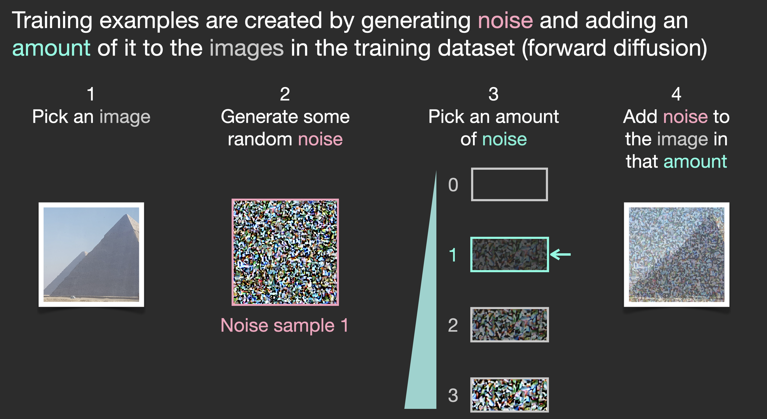
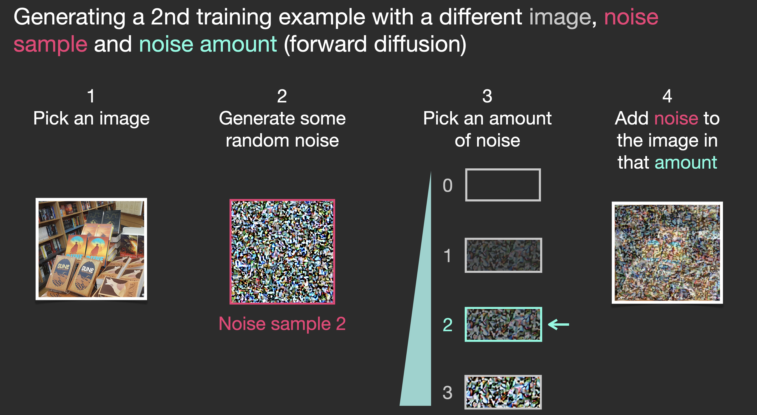
2- Forward Diffusion (Noising)
Stable Diffusion
Model
It takes data (image) in the latent space and adds noise to it.
We can produce a lot of training examples per sample for all samples of the training dataset.
Notes:
-It takes data (image) in the latent space and adds noise to it.
-It ’s used in creating different training examples for each sample of the training dataset by importing samples of training dataset to the model then it adds noise to them with different amount values (from amount 0, no noise, to amount 4, total noise). So we can add different amount of noise to each sample of the training dataset to produce a lot of training examples per sample for all samples of the training dataset.

Slide 18
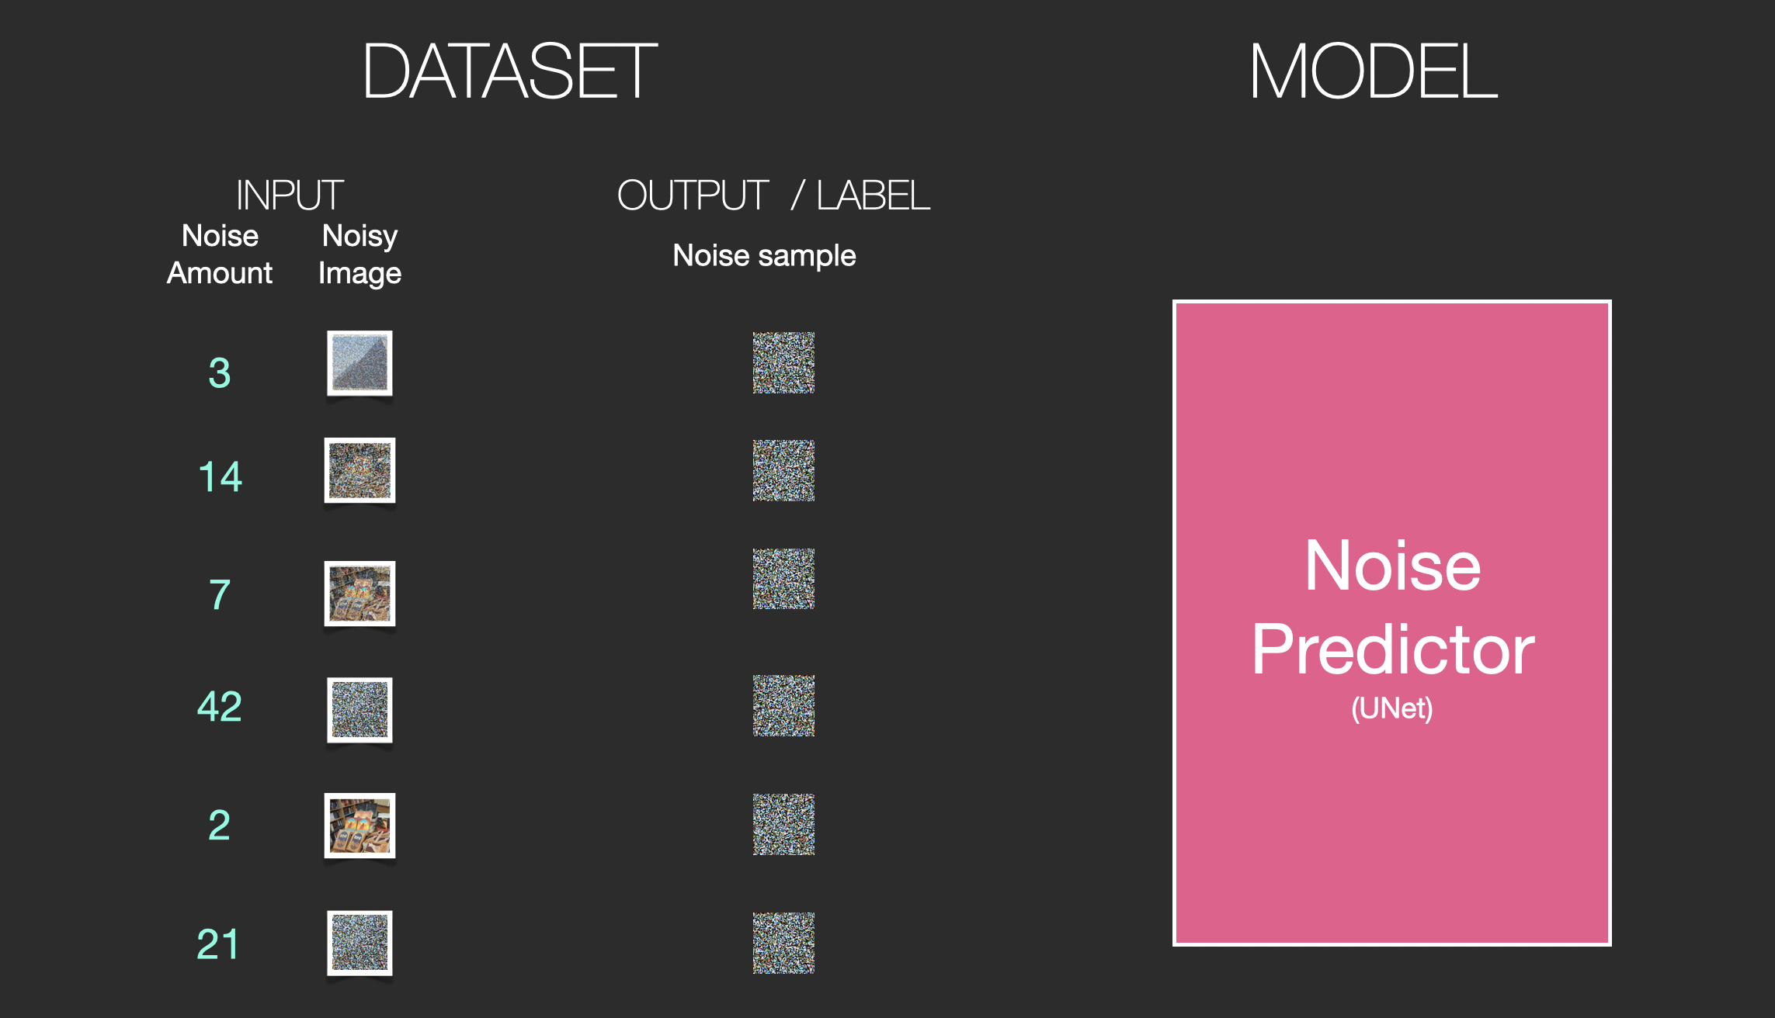
2- Forward Diffusion (Noising)
Stable Diffusion
Model
It takes data (image) in the latent space and adds noise to it.
We can produce a lot of training examples per sample for all samples of the training dataset.
Notes:
-It takes data (image) in the latent space and adds noise to it.
-It ’s used in creating different training examples for each sample of the training dataset by importing samples of training dataset to the model then it adds noise to them with different amount values (from amount 0, no noise, to amount 4, total noise). So we can add different amount of noise to each sample of the training dataset to produce a lot of training examples per sample for all samples of the training dataset.

Slide 19
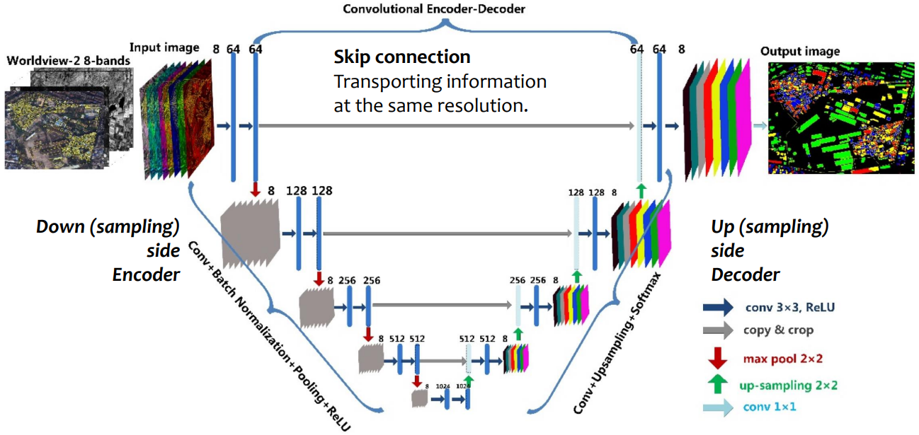
3- Reverse Diffusion (Noise Predictor) (Denoising)
Stable Diffusion
Model
It is mainly composed of a UNET which is an autoencoder neural network to remove noise from images.
This autoencoder can be implemented with Convolutional Neural Network (CNN) and inverted CNN as shown below.

Slide 20
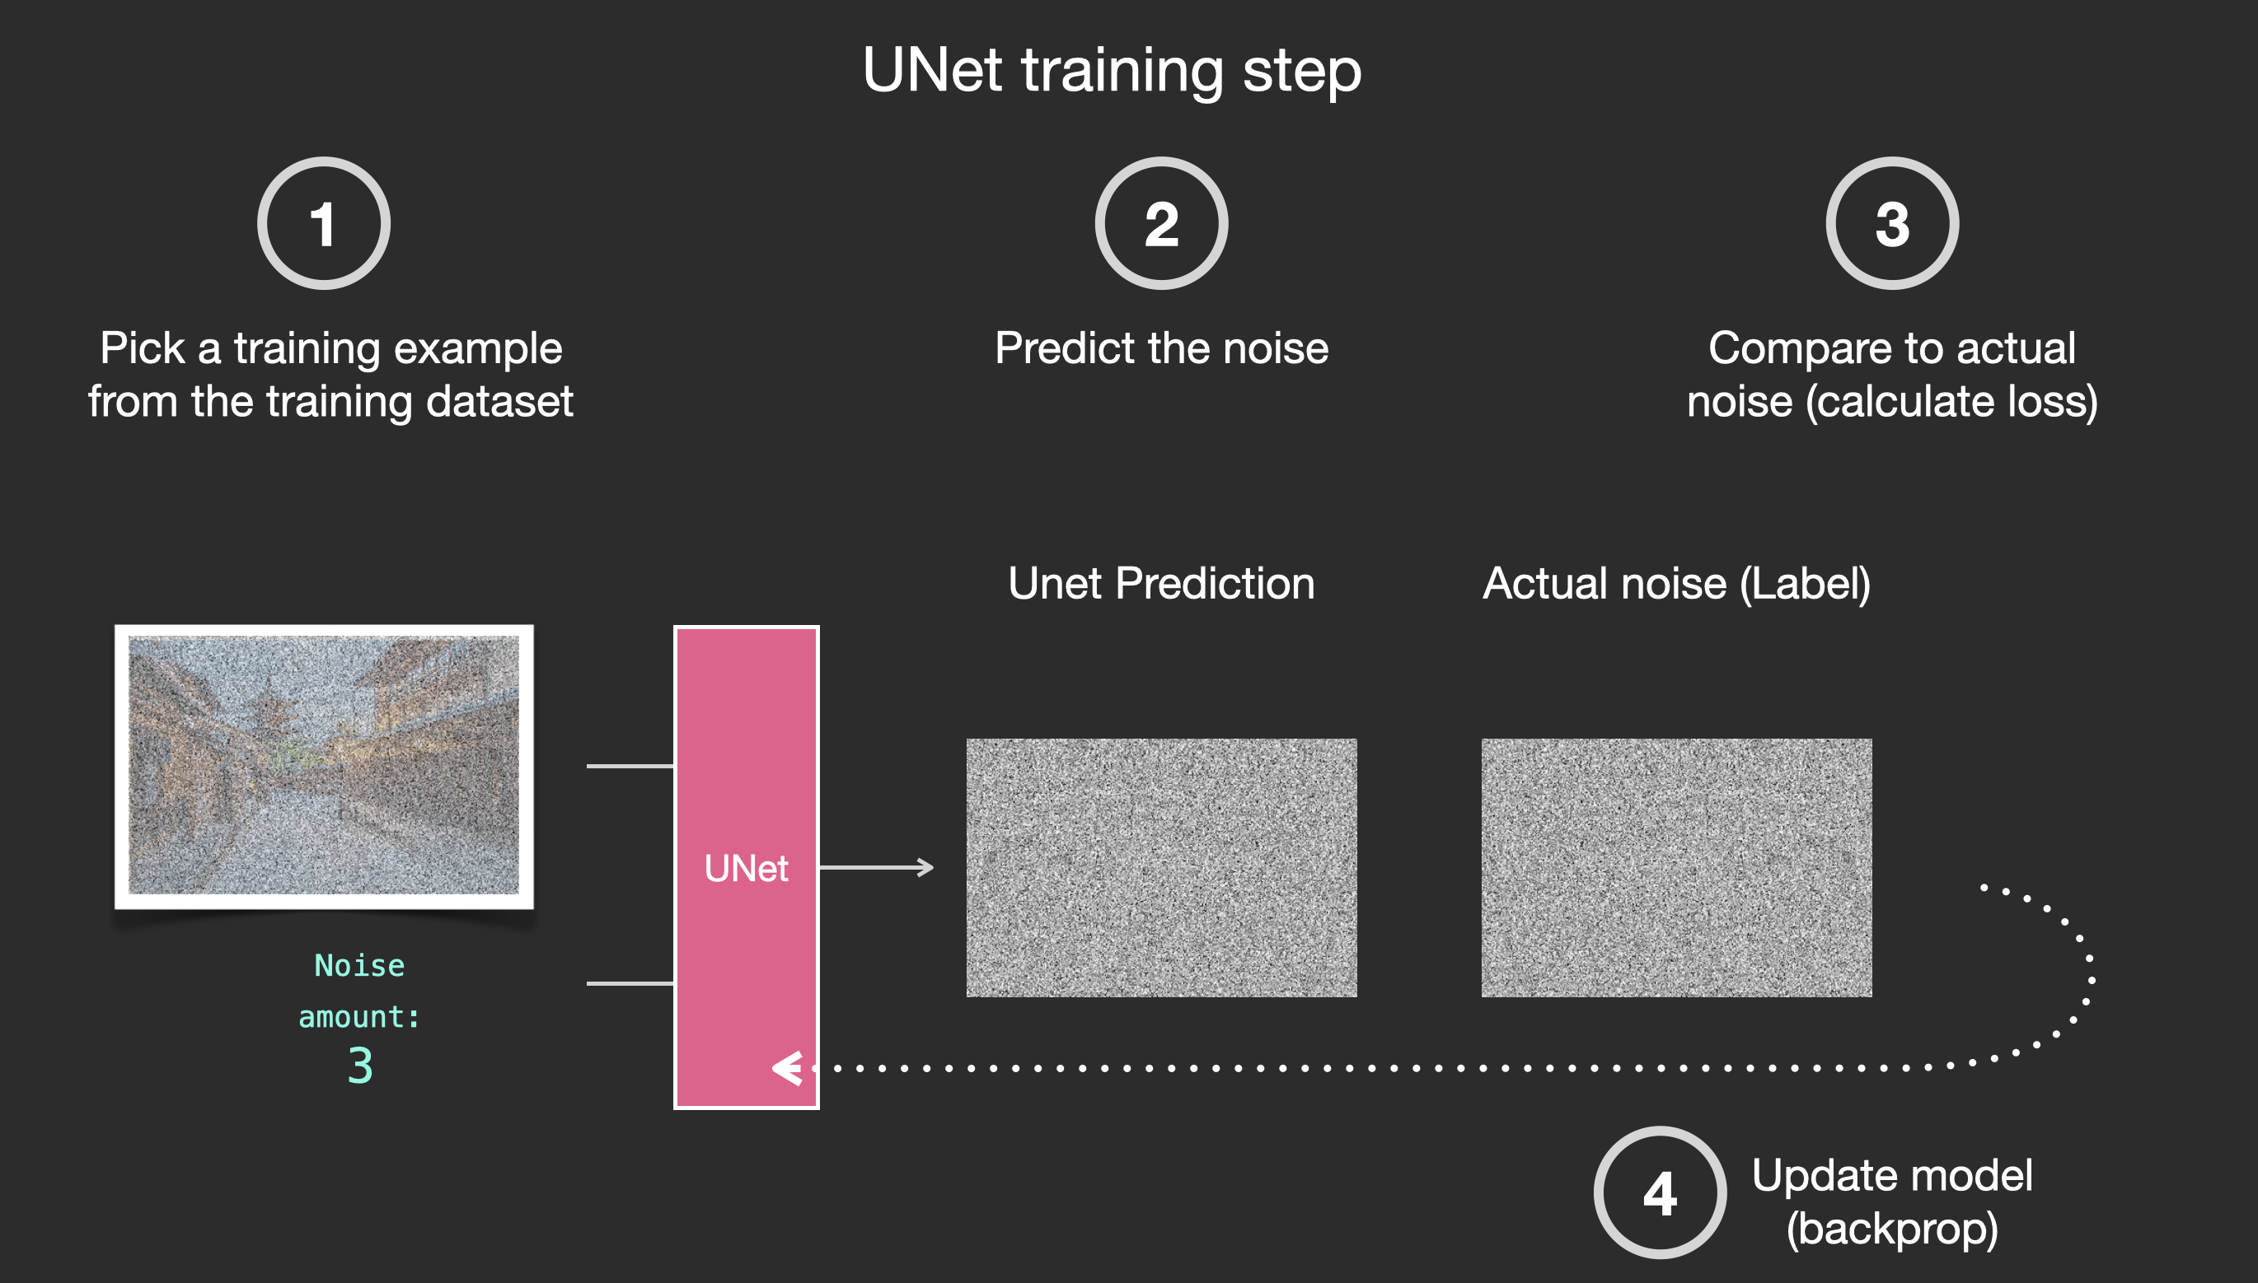
4- Training the model
Stable Diffusion
Model
With the training examples for all the samples of the training dataset, we can train the noise predictor and end up with a great noise predictor that actually creates images when run in a certain configuration.
Notes:
-With the training examples for all the samples of the training dataset, we can train the noise predictor and end up with a great noise predictor that actually creates images when run in a certain configuration.

Slide 21
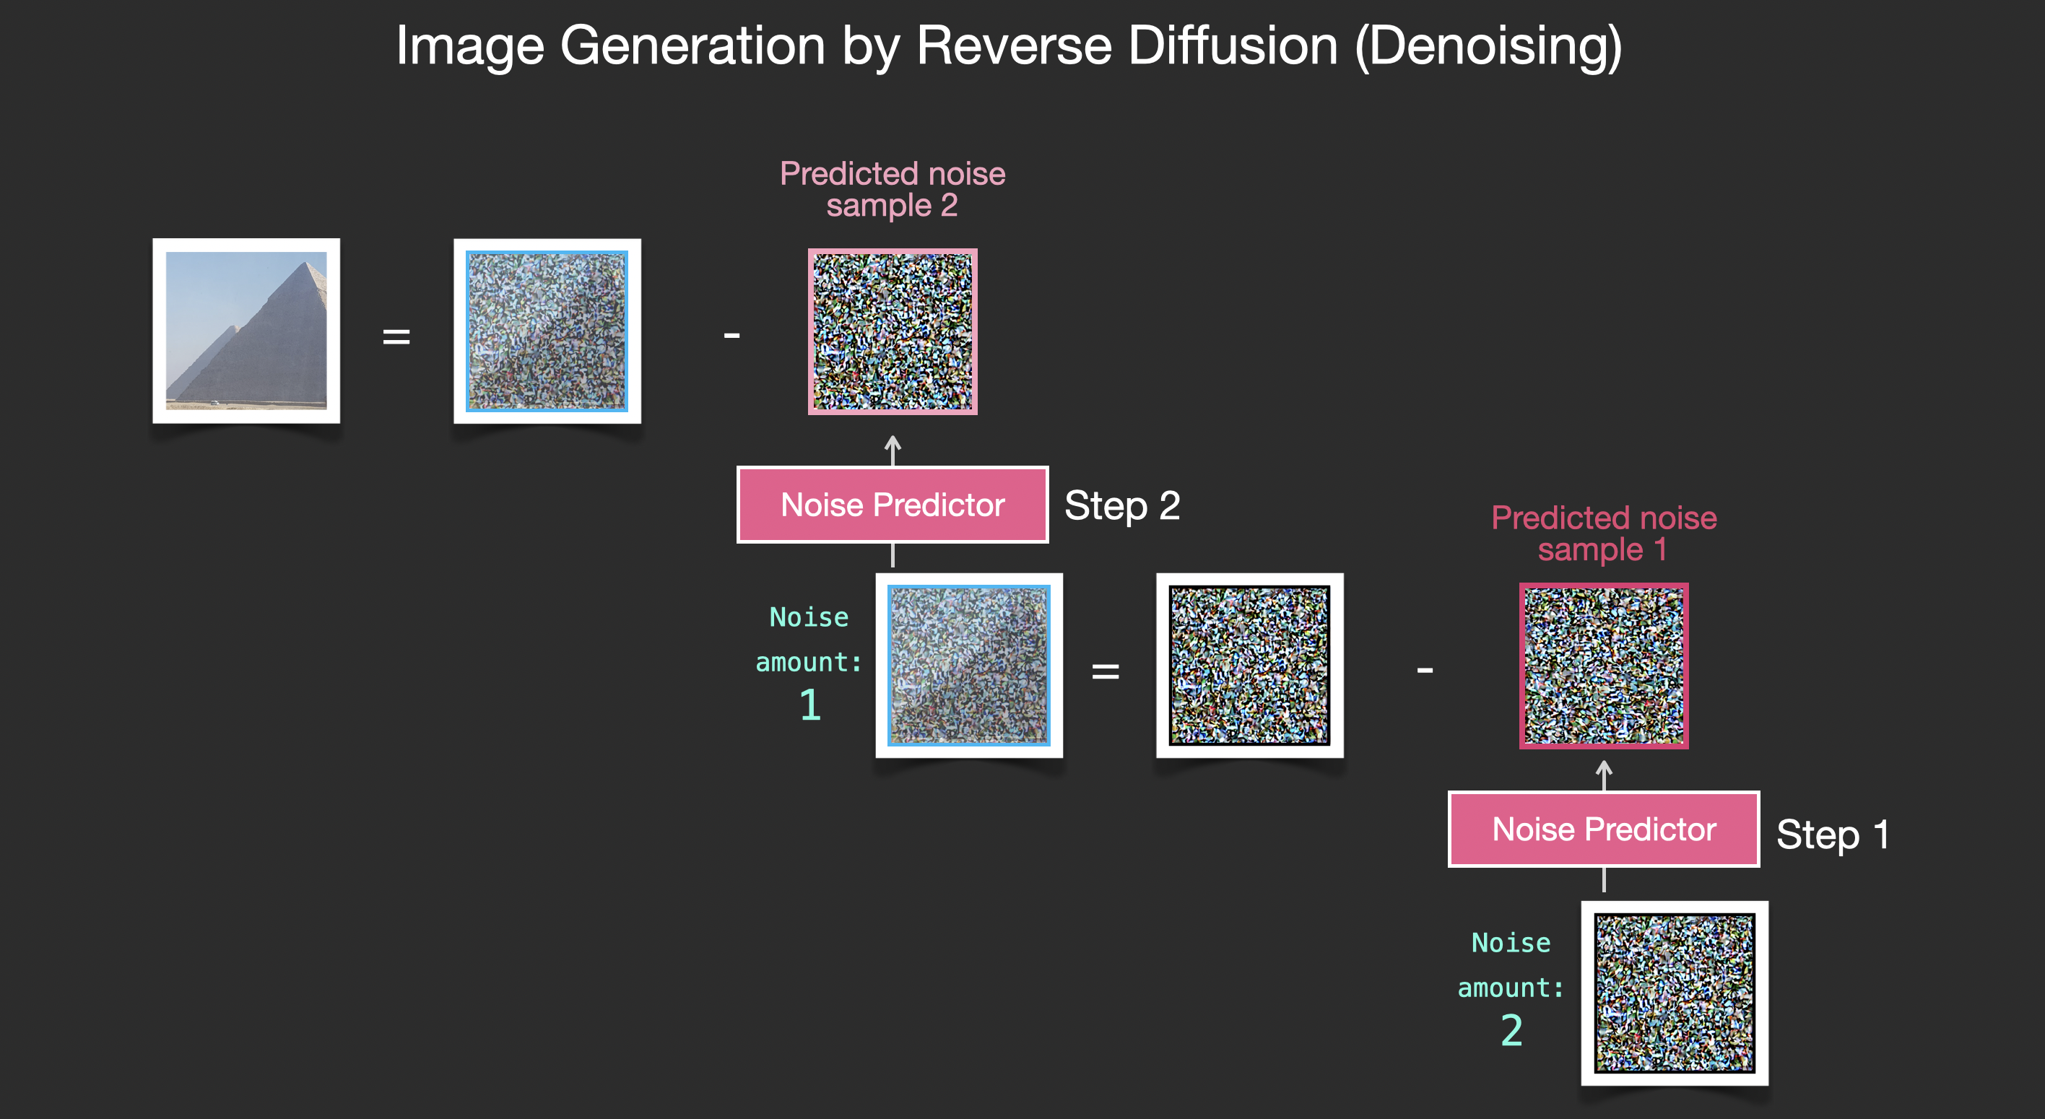
5- Painting images by removing noise (Predicting)
Stable Diffusion
Model
The trained noise predictor can take a noisy image, and the number of the denoising step, and is able to predict a slice of noise.
Notes:
-The trained noise predictor can take a noisy image, and the number of the denoising step, and is able to predict a slice of noise.
-The sampled noise is predicted so that if we subtract it from the image, we get an image that’s closer to the images the model was trained on.

Slide 22
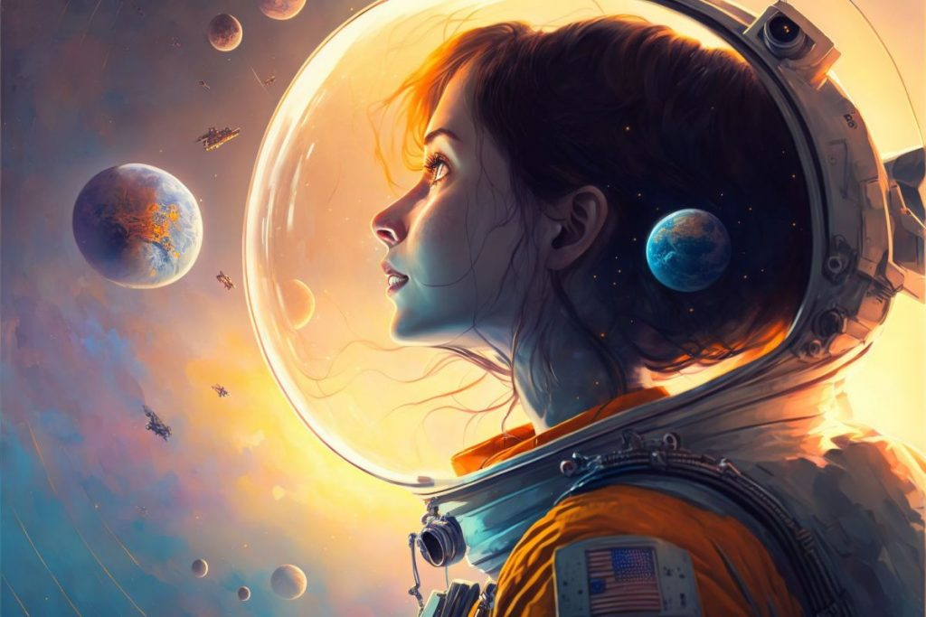
Content
Introduction
Model
Experiments & Results
Conclusion

Slide 23
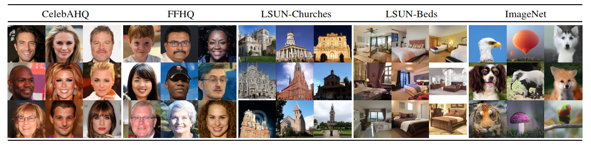
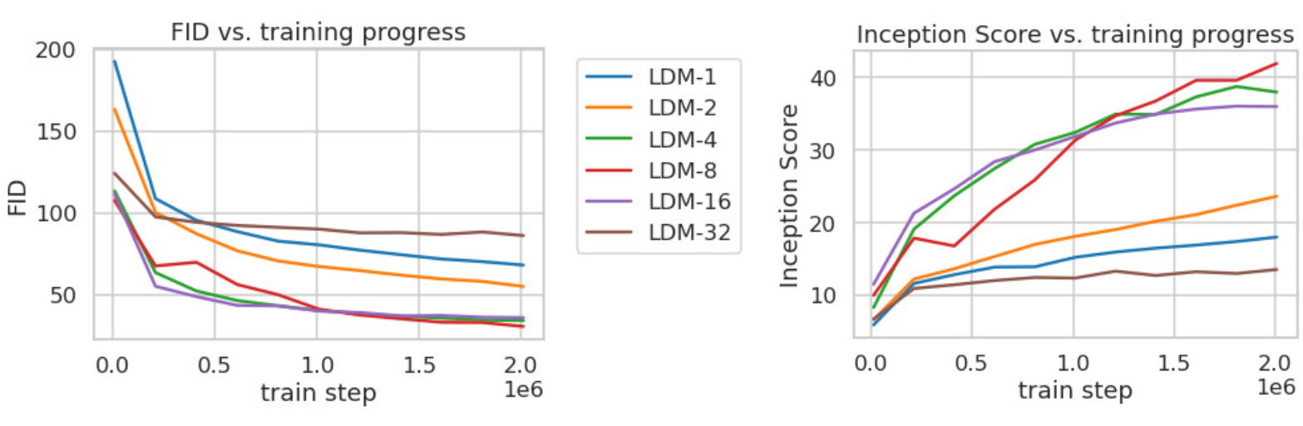
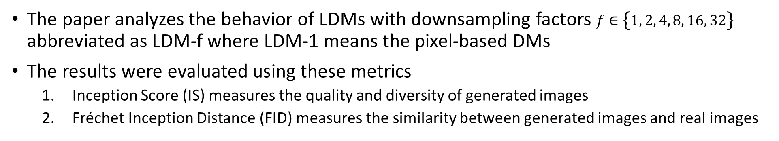
1. Compression Trade-off
Stable Diffusion
Experiments & Results
The LDM-4 and LDM-8 offer the best conditions to achieve high-quality synthesis results
The paper analyzes the behavior of LDMs with downsampling factors $f∈\left\{1, 2, 4, 8, 16, 32\right\}$ abbreviated as LDM-f where LDM-1 means the pixel-based DMs
The results were evaluated using these metrics
Inception Score (IS) measures the quality and diversity of generated images
Fréchet Inception Distance (FID) measures the similarity between generated images and real images

Slide 24
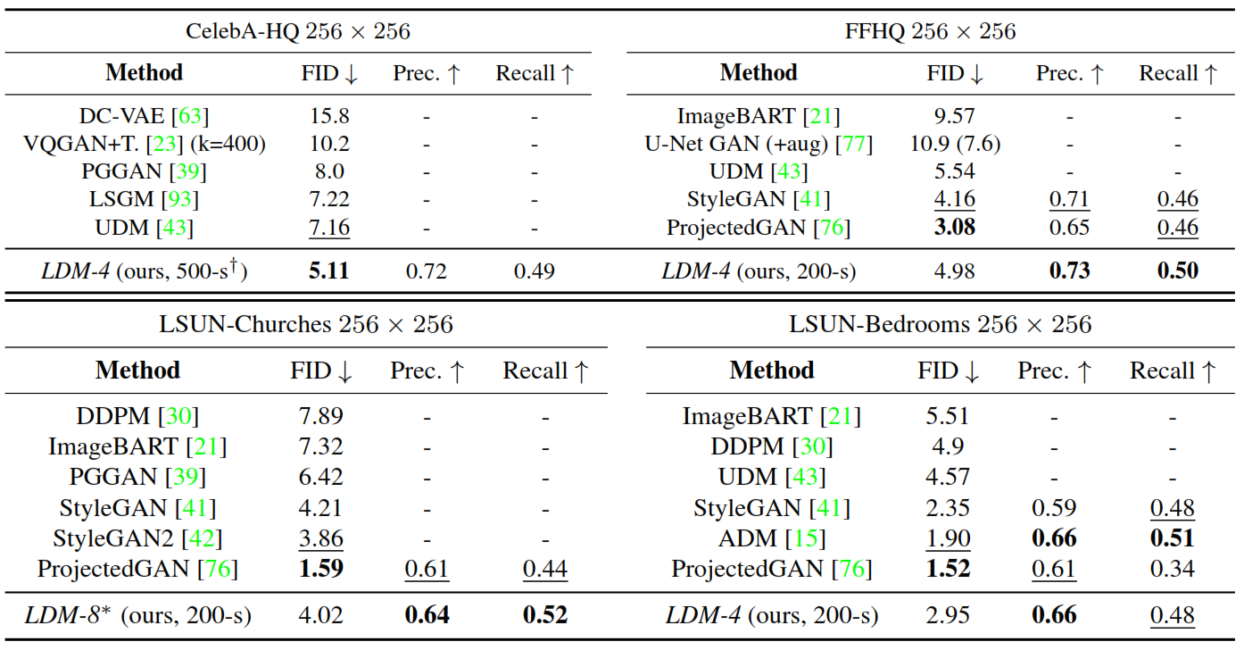
2. Image Generation with Latent Diffusion
Stable Diffusion
Experiments & Results
training of unconditional models of 256x256 images on the mentioned datasets. Then evaluate the quality using FID, Precision and Recall
A new state-of-the-art FID of 5.11
LDMs consistently improve upon GAN-based methods in Precision and Recall

Slide 25
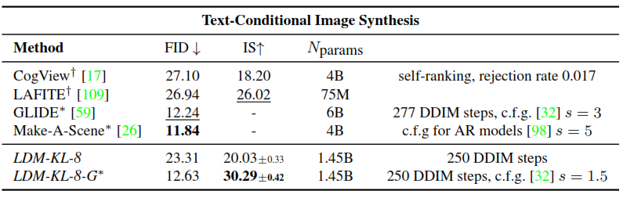
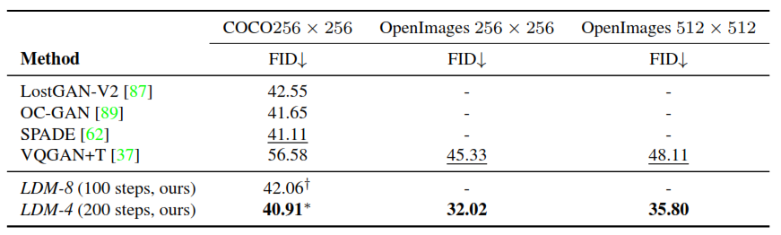
3. Conditional Latent Diffusion
Stable Diffusion
Experiments & Results
results after introducing cross-attention based conditioning into LDMs for the text-to-image synthesis
The paper follows prior work and evaluate text-to-image generation on the MS-COCO validation set

Slide 26
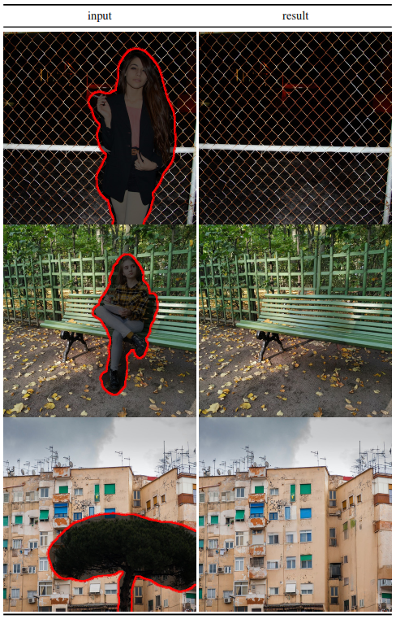
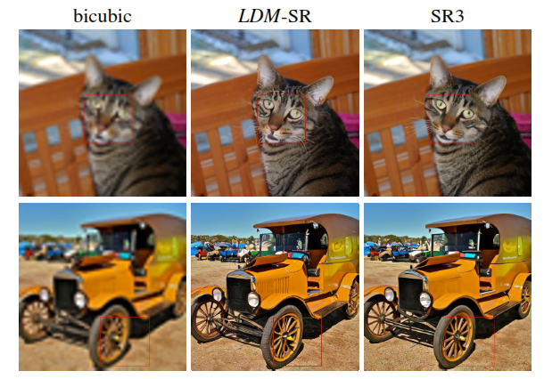
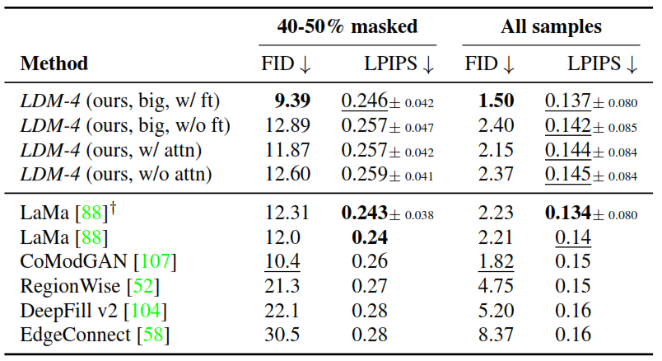
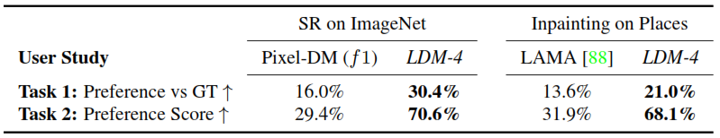
4. Super Resolution and Inpainting
Stable Diffusion
Experiments & Results
Compare super resolution with SR3
Compare Inpainting with LaMa

Slide 27
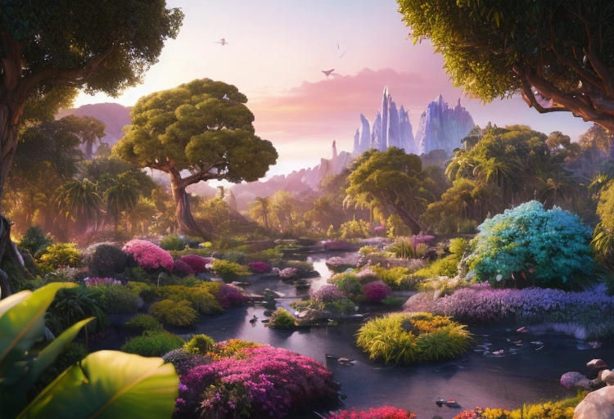
Content
Introduction
Model
Experiments & Results
Conclusion

Slide 28



Conclusion
Stable Diffusion
Conclusion
we presented a new trend that took over the internet over the past year which is text to image generation using stable diffusion
Many references influenced our understanding of the paper and stable diffusion concept
The Illustrated Stable Diffusion, Jay Alammar
Stable Diffusion Code first release code
Stable Diffusion Slides in Details

Slide 29
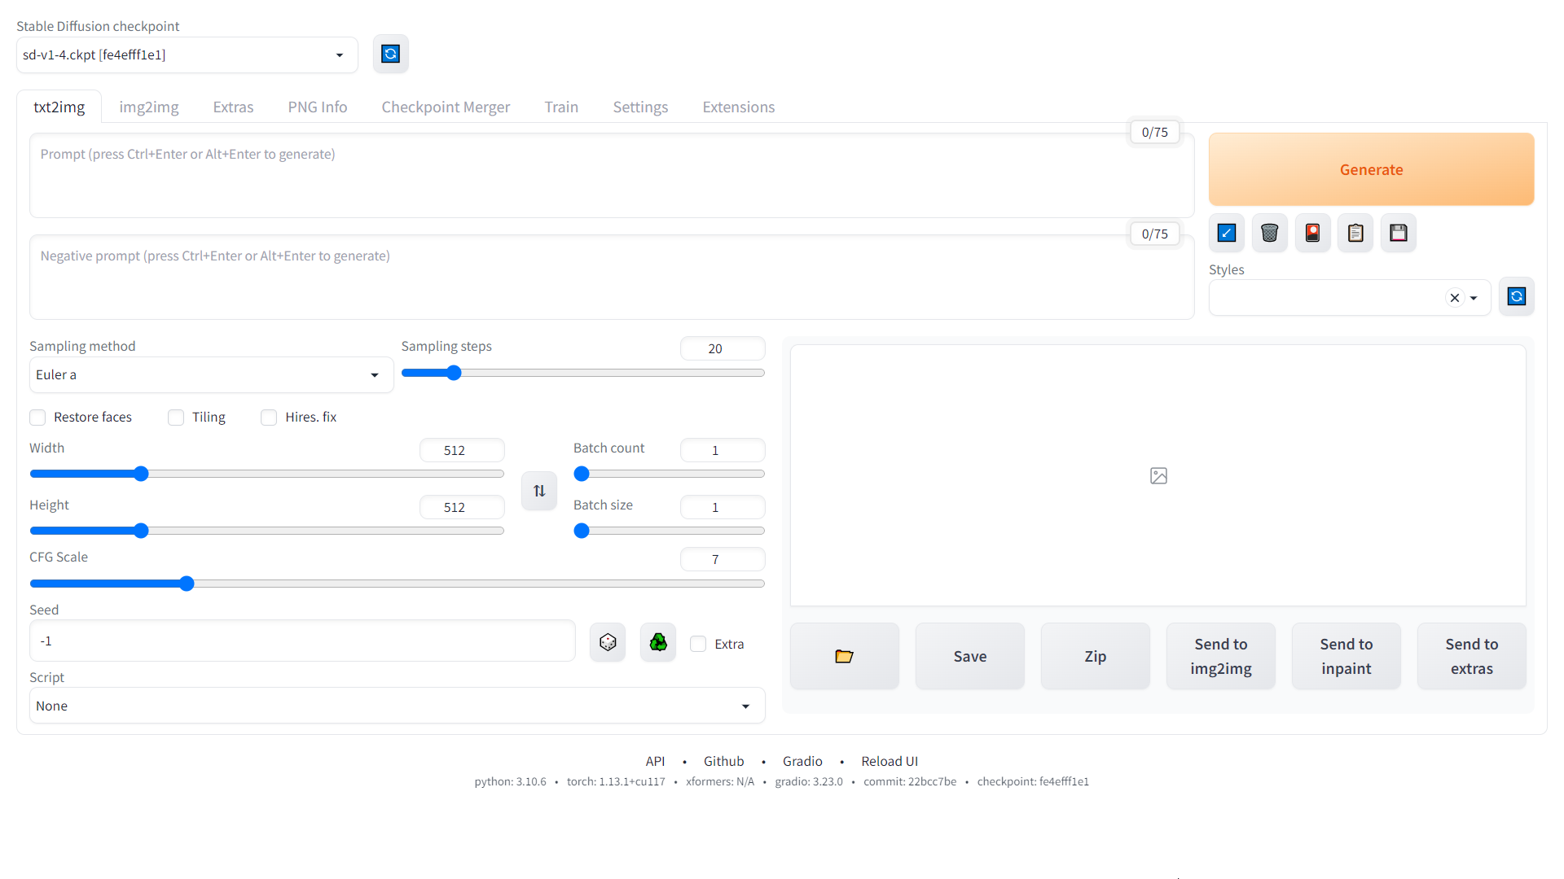
Try it Yourself !!
Stable Diffusion
Conclusion

Slide 30

Try it Yourself !!
Stable Diffusion
Conclusion
https://civitai.com

Slide 31
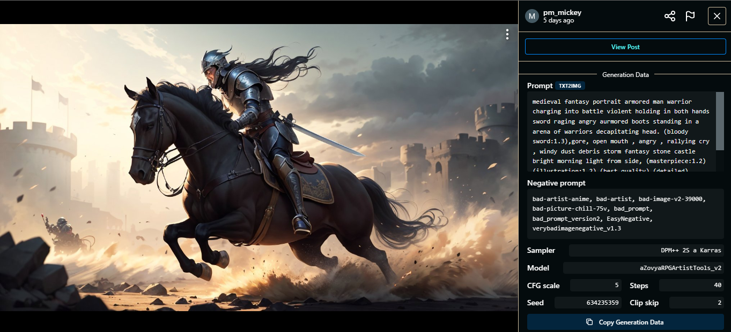

Slide 32
